Slide 1
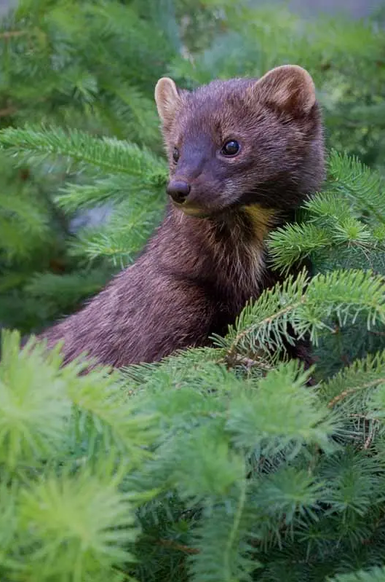
Why do fishers (Pekania pennanti) thrive in Albany, NY but reintroductions continue to fail in the Pacific NW?
Bri S., Hayden L., Sam K.,
Tim C., Danny M., Sherone S.

Slide 2
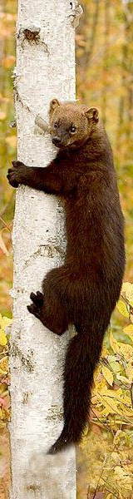
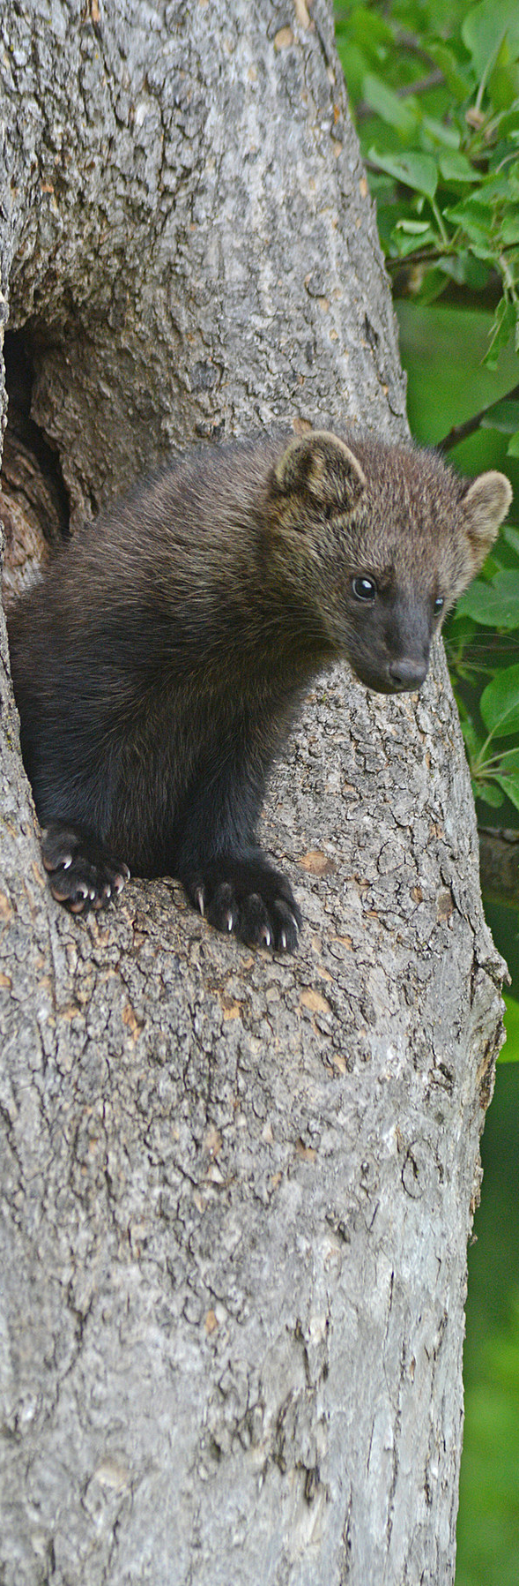
What are fishers? (U.S. Fish & Wildlife Service)
Pekan is the Abenaki word to describe the fisher
Sexually dimorphic mesocarnivores
IUCN: Least Concern
Monospecific genus with three subspecies (Hapeman et al. 2017)
pacifica, columbiana, and pennanti
Eat squirrels, mice, and birds
Live ~10 years
Prefer forests with a substantial canopy cover with tree cavities for denning

Slide 3
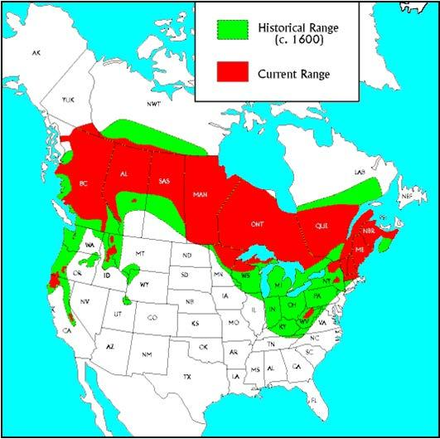
Historical Range
Native to North America
Found in boreal and mixed deciduous-coniferous forests (NYSDEC, 2015)
Over-trapping and habitat destruction in the 18th and 19th century caused the population to be considered endangered (Fogarty, 2022)
Range decreases and southern populations in the US diminish to small isolated groups.
Most U.S States banned fisher trapping in 1930’s
By 2011 fishers were removed from the endangered list but continue to struggle in the west.
Notes:
Found in boreal and mixed deciduous- coniferous forests (spanning from Nova Scotia all across the continent to the British Columbia) Population in the Southern Sierra Nevada has been isolated and dwindling for many 100 years

Slide 4
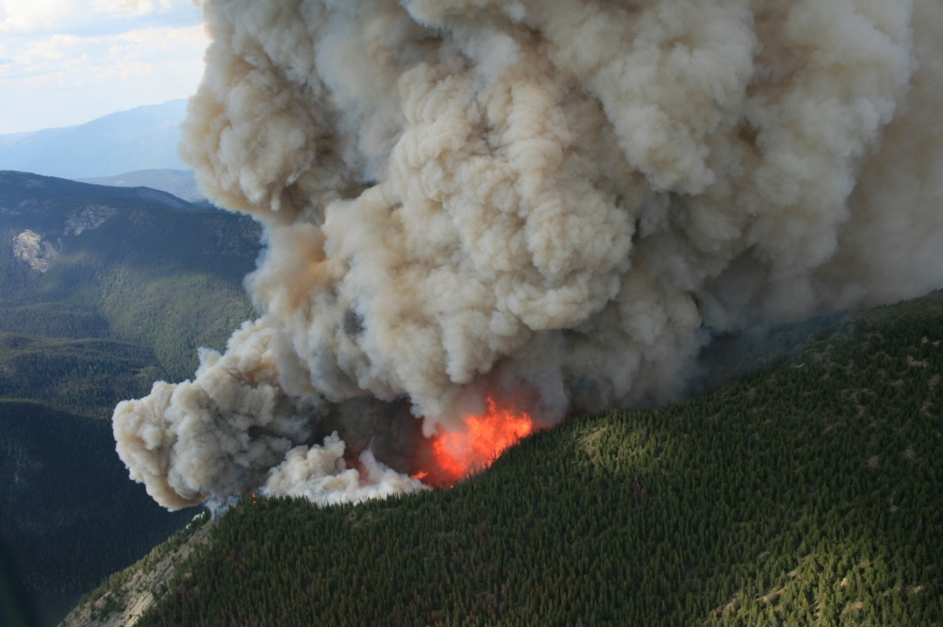
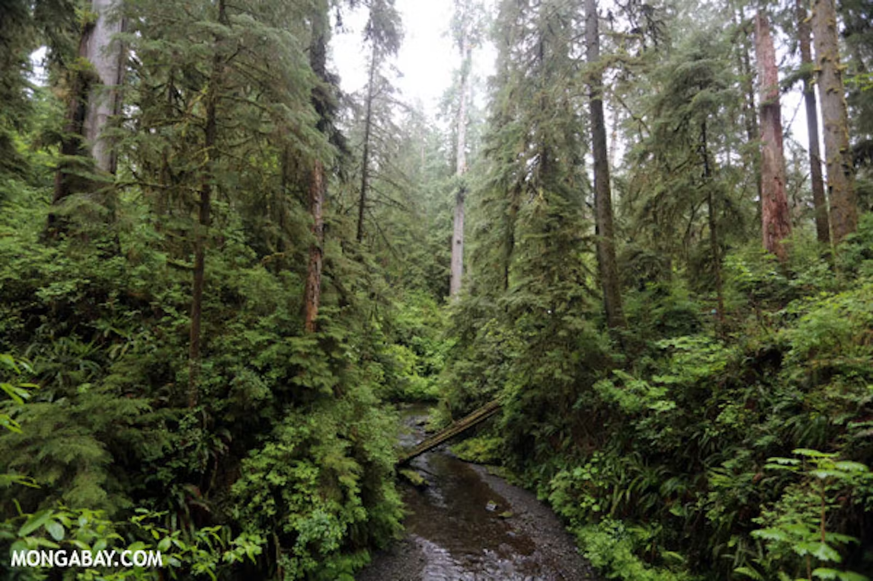
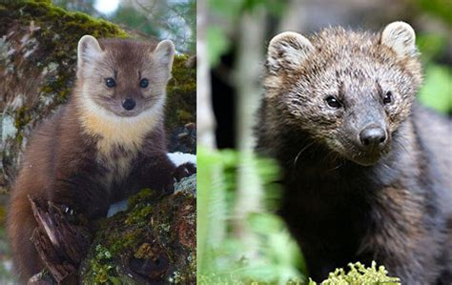
Reintroductions in the Pacific NW/why they are struggling
First Fisher reintroduction occurred in 2008, over a three year period 100 fishers were reintroduced to the Pacific NW (Lewis et al 2011)
By end of period, half of individuals were dead and most other half had an unknown status
Future projects past 2014 introduced more populations, and though some have re established breeding (Washington Department of Fish and Wildlife, it’s nowhere near past population ranges.
Logging and wildfires in the NW often remove forests critical for Fisher use (Aubry et al 2003)
American Martens (Martes americana) overlap in Fisher habitat, distribution, and niche, including in the NW
Though Martens are often outcompeted by Fishers in other regions (Manlick et al 2017), it’s possible that it’s the inverse in the NW with Martens suppressing the niche space for Fishers

Slide 5
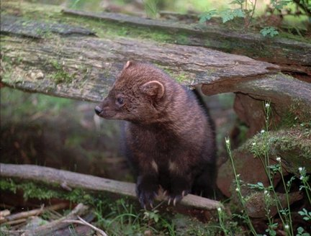
Populations thriving in Albany
Naive prey
Prey may have forgotten the threat of fishers.
Prey may become aware and fisher populations may collapse once food is harder to get.
Behavioral
The fishers in Albany changed their active hours to avoid humans.
Making and using natural city corridors to travel over large areas within cities
(LaPoint, 2013)

Slide 6
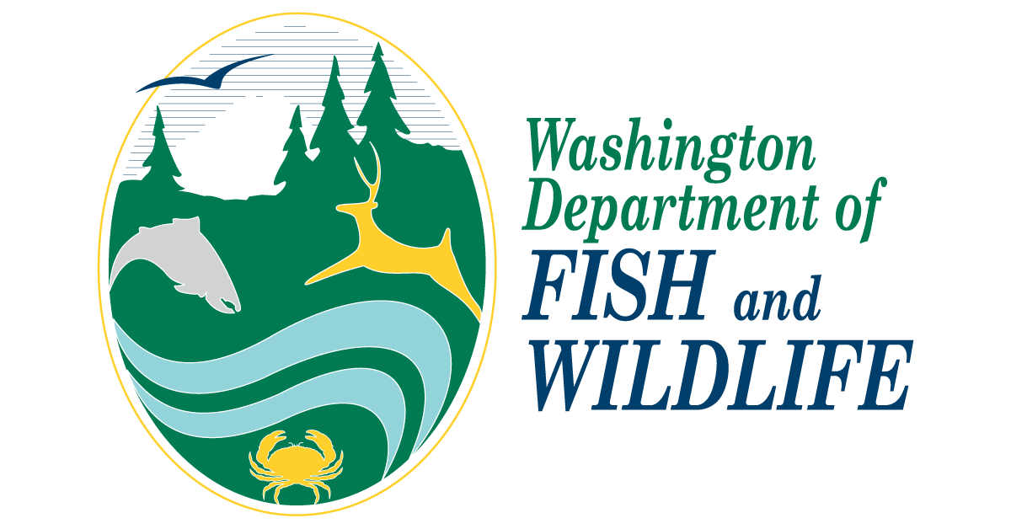
Interview with Dr. Jeffrey Lewis
Human Impact on Fishers
A clip from our interview with Dr. Jeffrey Lewis; How people are part of the problem.

Slide 7
Hypotheses- Why are they failing?
- “The things that you worry about the most is predators… but we haven’t found that to be the case”
- Jeff Lewis, on the Cascade Mountain Fisher reintroduction effort
- Wildfires, Logging, Predators are main concerns
- Parasites, brought in from source species
- Human impact
- Prey interactions in Albany could account for success

Slide 8
Conclusion
Niche compression and the unregulated growth of American martens in the Pacific NW have led to the unsuccessful reintroduction of Pacific fishers in that area (Hiller 2015).
Alternatively, behavioral changes and revised management plans have allowed them to thrive in Albany (NYSDEC 2015).

Slide 9
Literature Cited
Aubry, K. B., Lewis, J.C. 2003. Extirpation and reintroduction of fishers (Martes pennanti) in Oregon: implications for their conservation in the Pacific States. Biological Conservation 114: 79-90 https://doi.org/10.1016/S0006-3207(03)00003-X
Fogarty, R., R. Weir, E. Lofroth, and K. Larsen. 2022. Trapping mortality accelerates the decline of the fisher, an endangered mesocarnivore, in British Columbia, Canada. Endangered Species Research 49:1–12.
Hapeman, P., E. K. Latch, O. E. Rhodes, B. Swanson, and C. W. Kilpatrick. 2017. Genetic population structure of fishers (Pekania pennanti) in the Great Lakes region: remnants and reintroductions. Canadian Journal of Zoology 95:869–876.
Hiller, T. L. 2015. Feasibility assessment for the reintroduction of fishers in western Oregon, USA. U.S. Fish and Wildlife Service, Portland, Oregon, USA.
LaPoint, S.D (2013). Movement ecology of fishers (Pekania pennanti) within a semi-urban landscape:163.
Lewis, J.C., Happe, P.J., Jenkins, K.J., Manson, D.J. 2011. Olympic Fisher Reintroduction Project: Progress Report 2008-2011 https://wdfw.wa.gov/sites/default/files/publications/01393/wdfw01393.pdf
Lewis, J. November 18, 2022. Video Interview.
Manlick, P. J., Woodford, J. E., Zuckerberg, B., Pauli, J. N. 2017 Niche compression intensifies competition between reintroduced American martens (Martes americana) and fishers (Pekania pennanti). Journal of Mammalogy 93: 690-702 https://doi.org/10.1093/jmammal/gyx030
New York State Department of Environmental Conservation (NYSDEC). 2015. New York State Fisher Management Plan. Albany, NY.
U.S. Fish & Wildlife Service. (n.d.). Fisher (Pekania pennanti). https://www.fws.gov/species/fisher-pekania-pennanti.

Slide 10
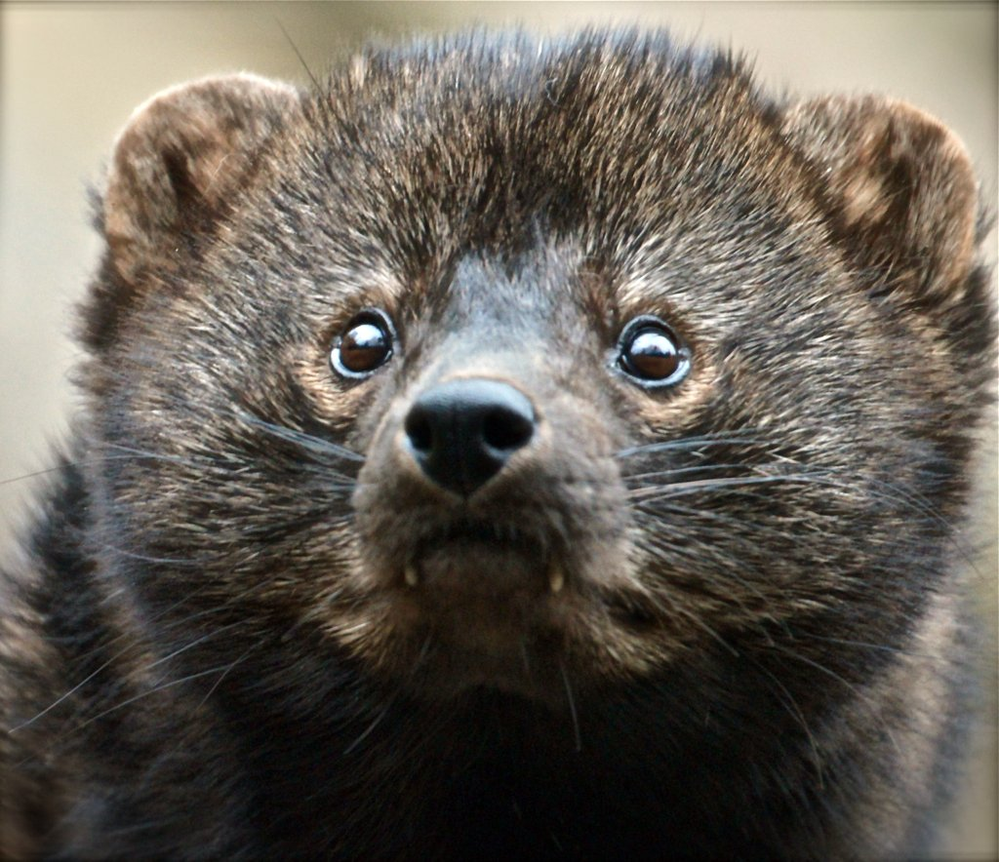
Questions?

